Slide 1
Watch ToGether clone platform

Slide 2
Watch together
Video watching platform for friends for YouTube links.
watching
Play videos simultaneously, pause.
Chat with each other.
Account creation.
Friends list.
Playlist system.
Voting system for skipping videos.

Slide 3
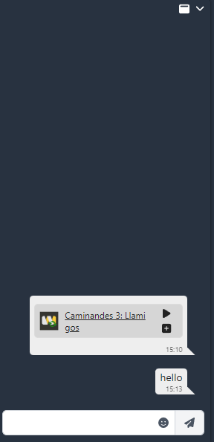
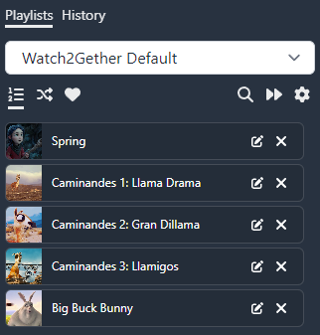
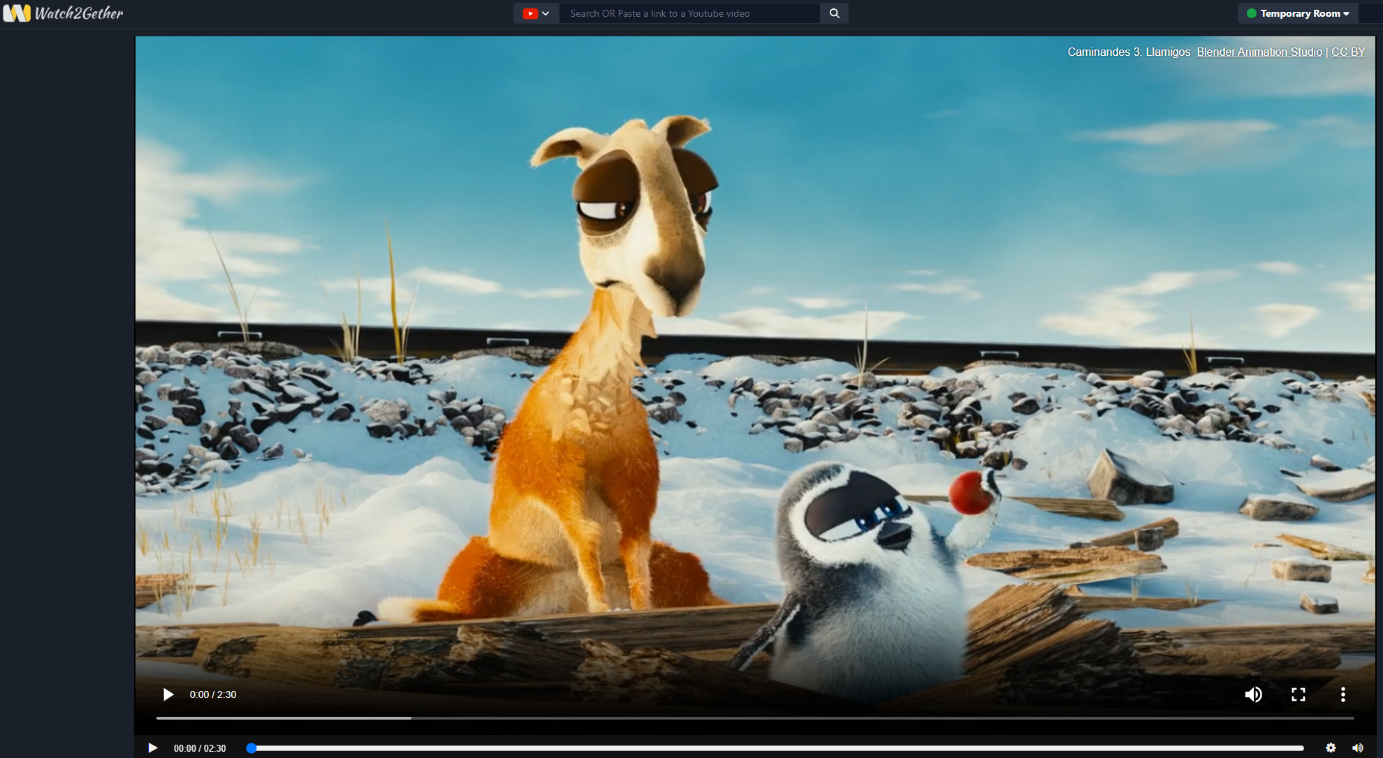
Non-functional Requirements
Scalability.
Performance.
Security.
Usability.
Performance Monitoring & Analytics.

Slide 4
How will I achieve this
Microservice architecture, WebSocket communication
Java, Go, Python.
Javascript, Go
Scrum, 5 sprints 3 weeks

Slide 5

Thank you
Any Questions?

